Slide 1
STUDENT MANAGEMENT SYSTEM (USING MICROSERVICES)
- By Aditya More

Slide 2
Content
Introduction
Objectives
Requirements
Database Design
Services
Working
Conclusion

Slide 3
Introduction
Creating a API for student management using standards
The project gives basic idea about microservices implementation and working
Designing a database with entity relationship diagram
Mapping different entities using frameworks in Java
Logging and its importance for up and running services

Slide 4
Objectives
Creating a database using MySQL for student management system
Creating a basic Spring-boot project using Spring Data JPA
Use microservices architecture for different services
Also implement logging in each service
Perform all basic CRUD operations on services

Slide 5
Requirements
IDE: Intellij Idea
Framework and libraries : Spring-boot, JPA, Hibernate etc.
Tools: MySQL Workbench, Postman for API testing etc.

Slide 6
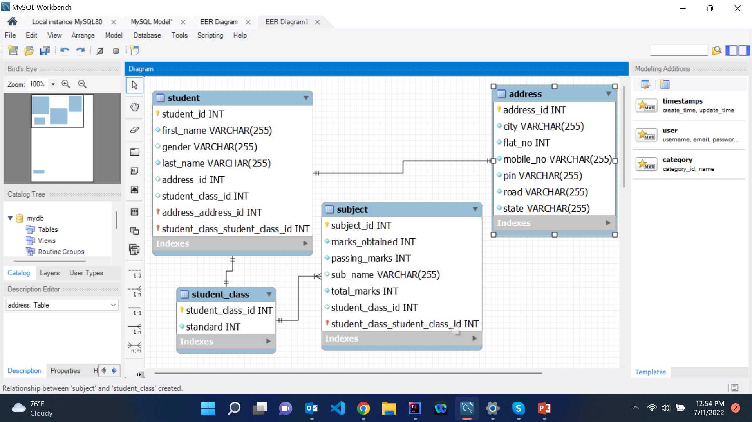
Database Design

Slide 7
Services
Students
Addresses
Student Class (Standard)
Subjects

Slide 8
Working (CRUD)
Create Student Entity using Post method
Get all Students
Get all Students using Pagination
Get Student by their ID
Delete a Student by their ID
Edit student information

Slide 9
Conclusion
All the services should work independently for scalability and maintenance
Logging provides necessary information about processes and changes for security purpose

